Slide 1
Diabetes Classification
Using Machine Learning
Lithigesh P G – [CB.EN.U4CCE23025]
Nivas G – [CB.EN.U4CCE23030]
Praveen S – [CB.EN.U4CCE23035]

Slide 2
Bi-Weekly Plans
Week 1-2: Understanding the Dataset and Pre-processing - Perform data preprocessing such as label encoding, handling missing values, removing duplicates and handling class imbalance using SMOTE.
- Handling outliers, normalization and feature selection and extraction.
Week 3-4: K-Means clustering and KNN - Implementing machine learning model for diabetes classification such as K-Means clustering and KNN (K Nearest Neighbors).
Week 5-6: Logistic Regression and Decision tree - Performing logistic regression for multiclass diabetes classification. - Implementing decision tree using gini index as split criterion.

Slide 3
Bi-Weekly Plans
Week 7-8: Random Forest and SVM - Implementing machine learning models for diabetes classification such as Random Forest and Support Vector Machine (SVM).
Week 9-10: Naïve Bayes and Neural Network - Implementing machine learning models for diabetes classification such as Naïve Bayes and Neural Network.
Week 11-12: Result Analysis and Report
- Analyzing the performance of implemented machine learning models for diabetes classification.
- Documenting findings and preparing the final report

Slide 4
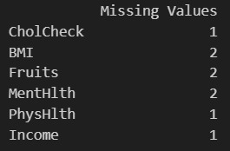
Data Pre-processing
ENCODING:-
- Label encoding for categorical columns
MISSING VALUES:-
DUPLICATES HANDLING:-

Slide 5
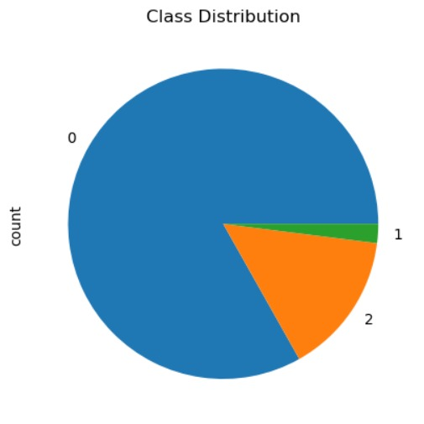
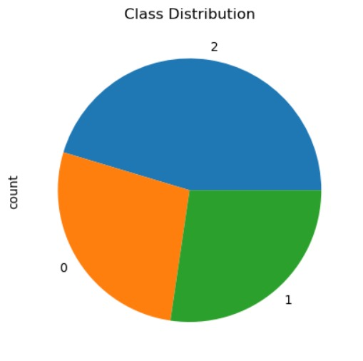
Data Pre-processing
CLASS IMBALANCE HANDLING USING SMOTE:-

Slide 6

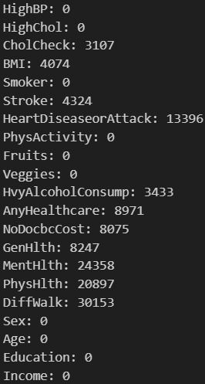
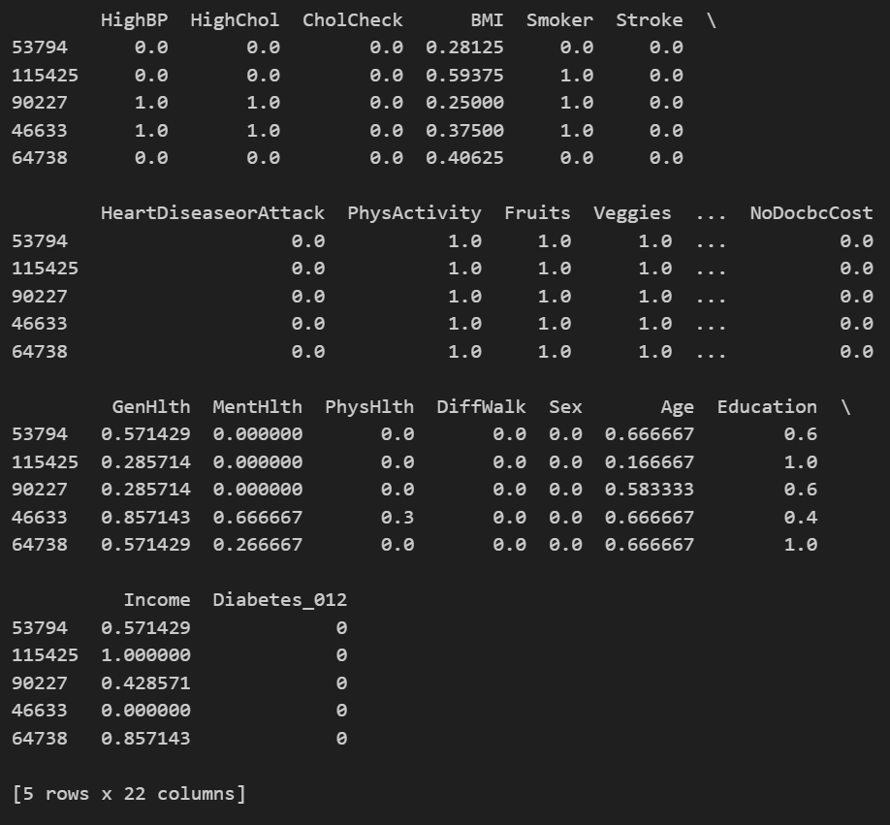
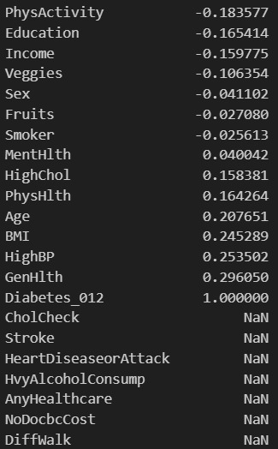
OUTLIER HANDLING:-
NORMALIZATION:-
FEATURE EXTRACTION:-

Slide 7
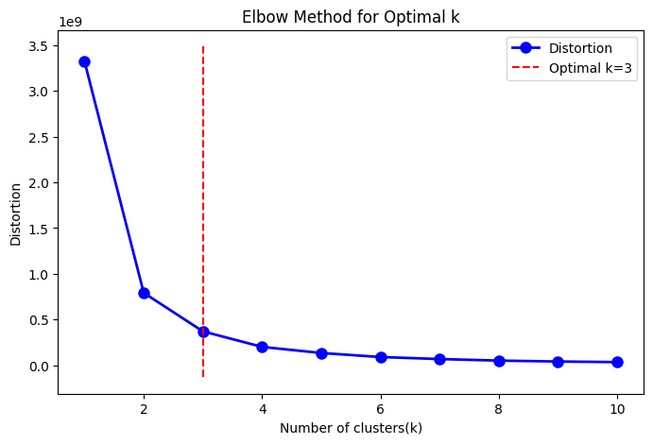
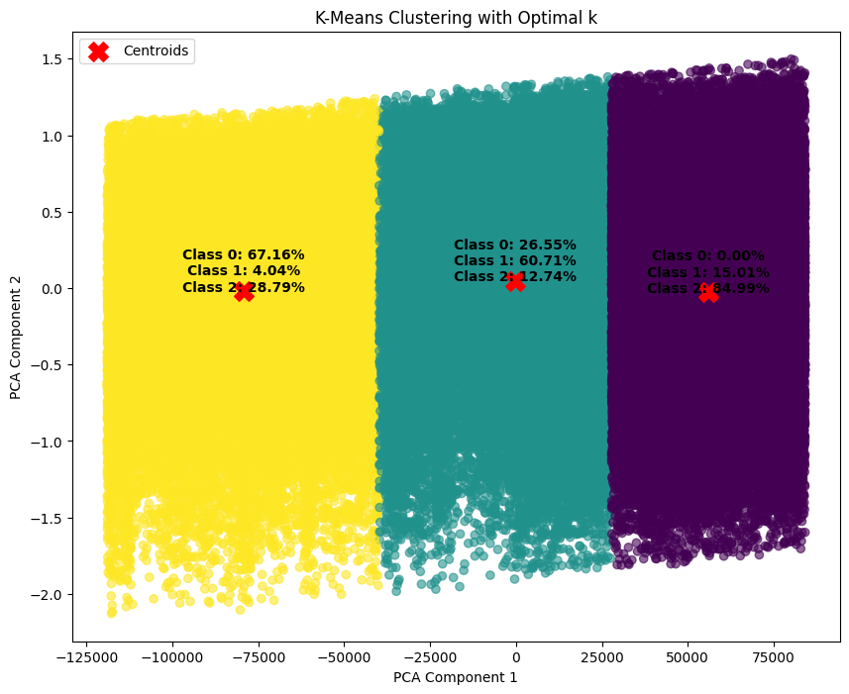
K – Means Clustering

Slide 8
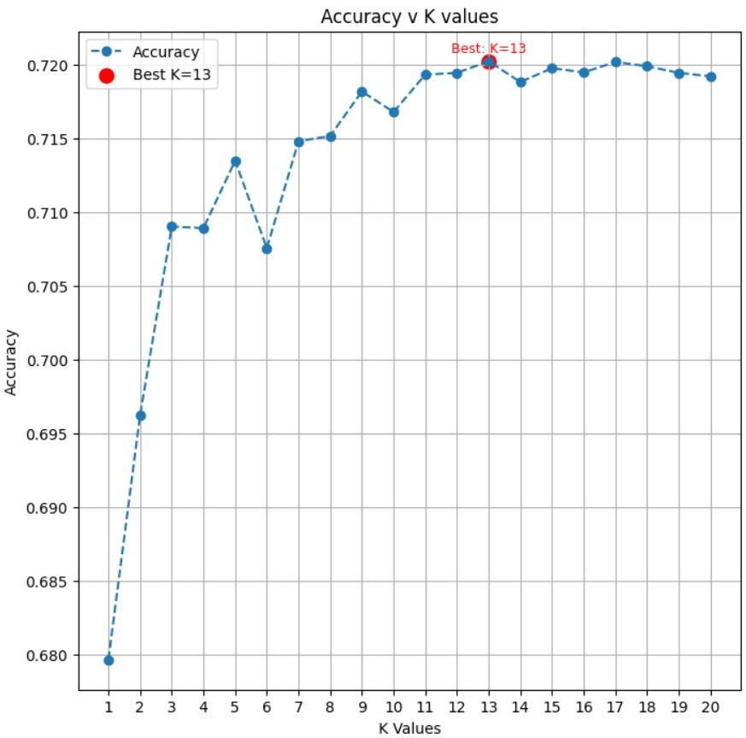
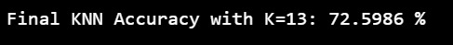
K Nearest Neighbors

Slide 9
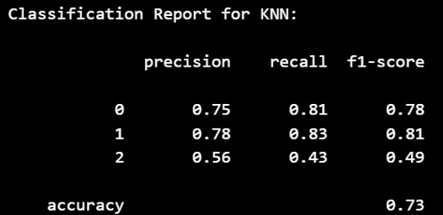
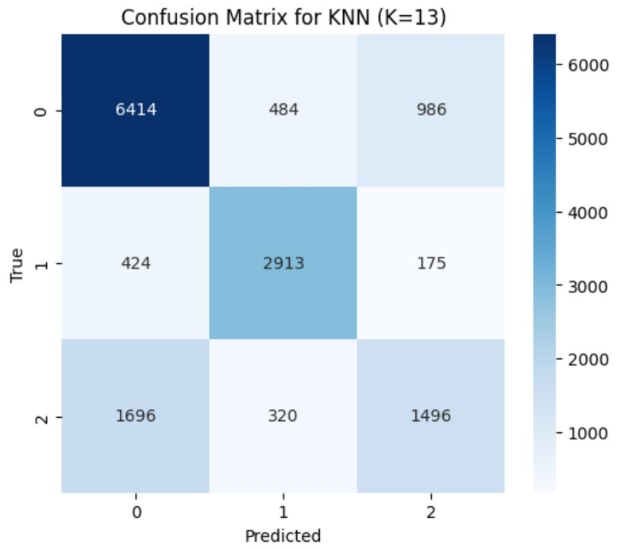
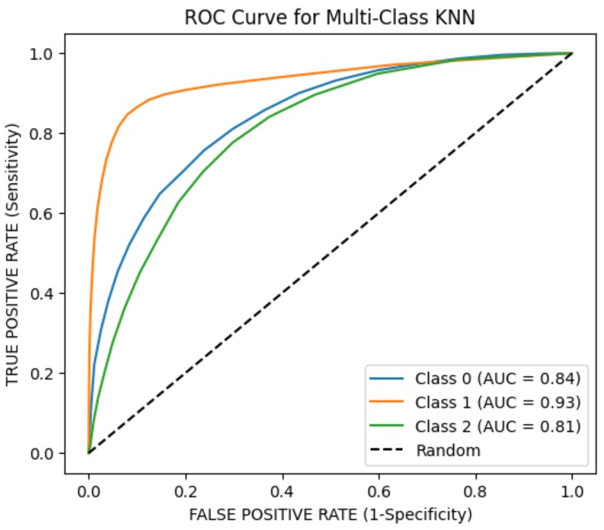
K Nearest Neighbors

Slide 10
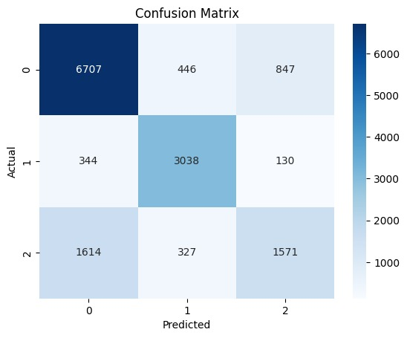
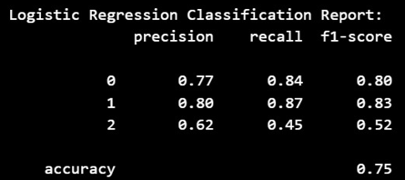
Logistic Regression

Slide 11
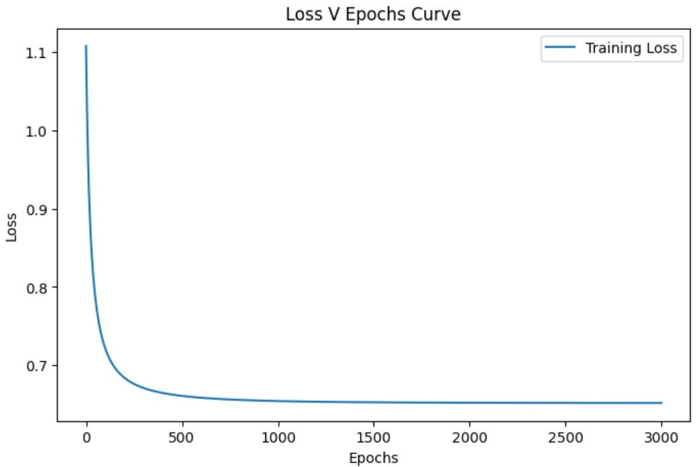
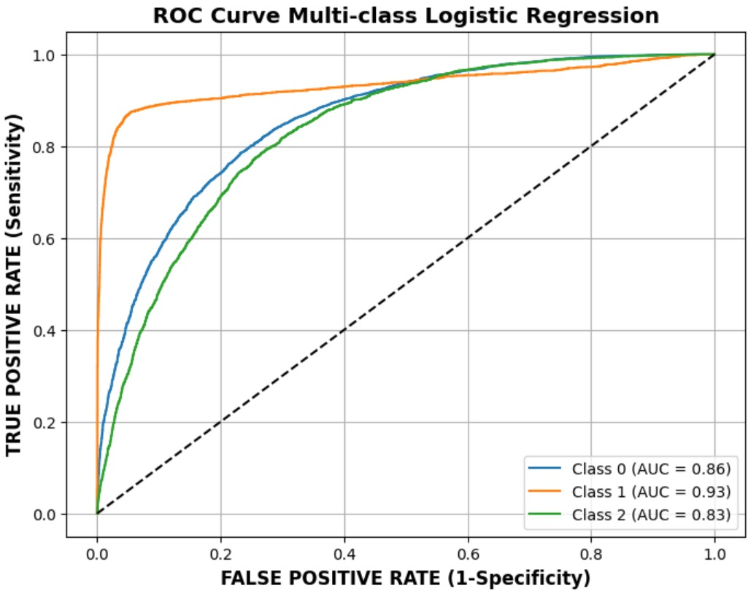
Logistic Regression

Slide 12
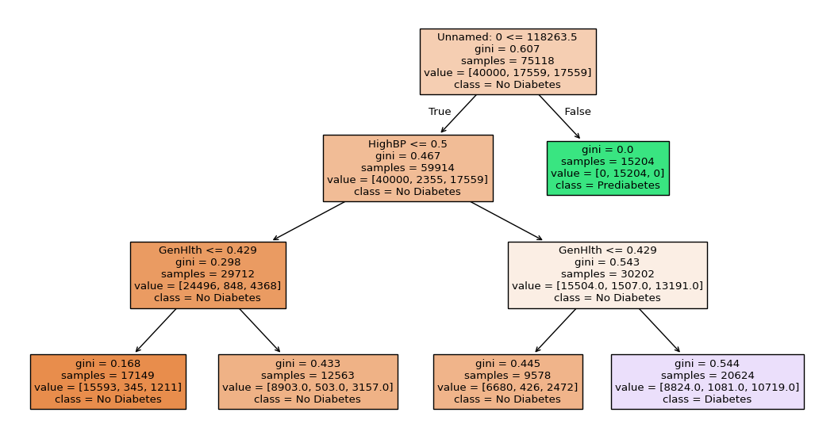
Decision Tree

Slide 13
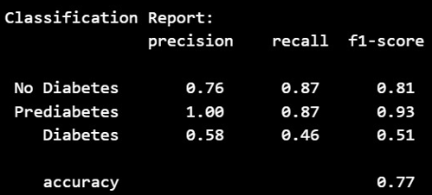
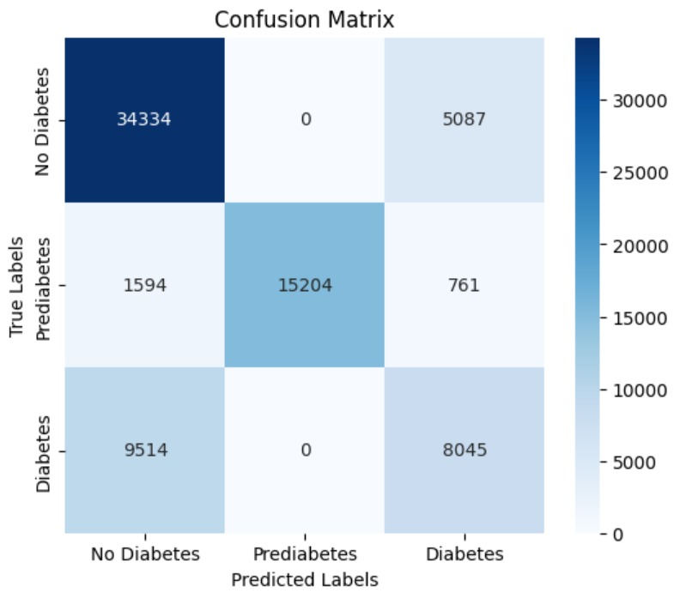
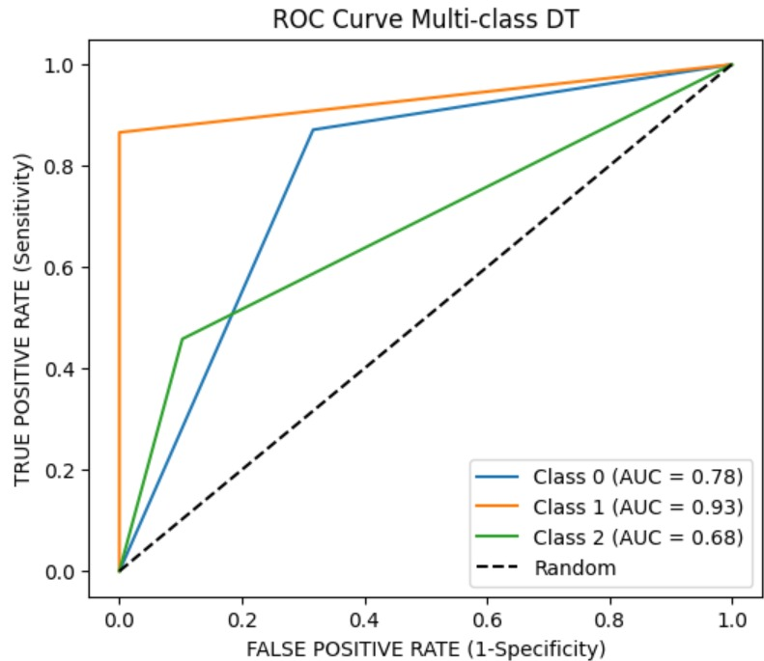
Decision Tree

Slide 14
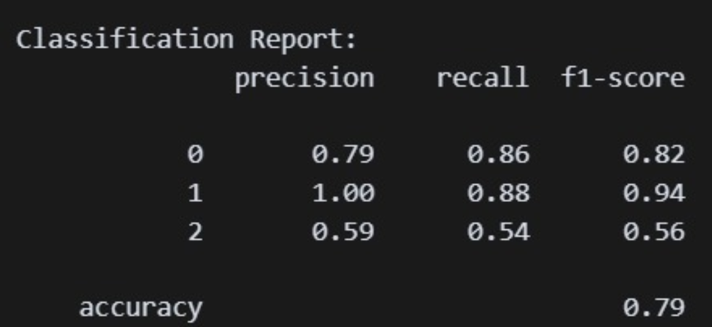
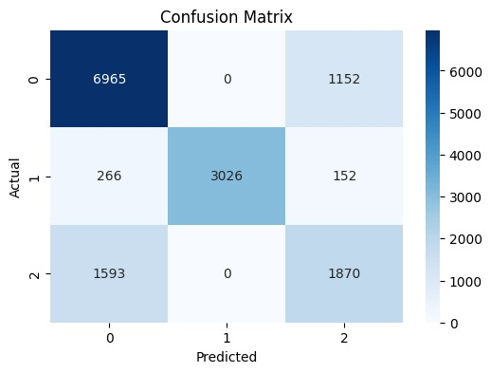
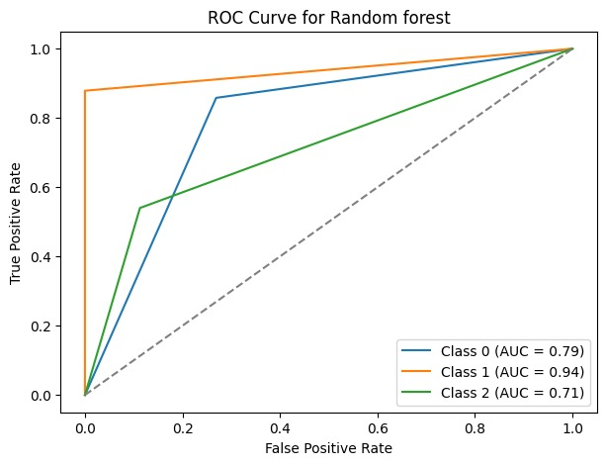
Random Forest

Slide 15
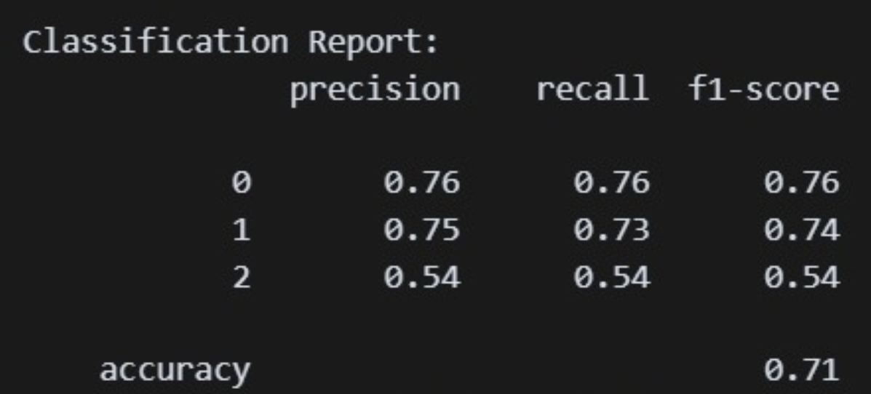


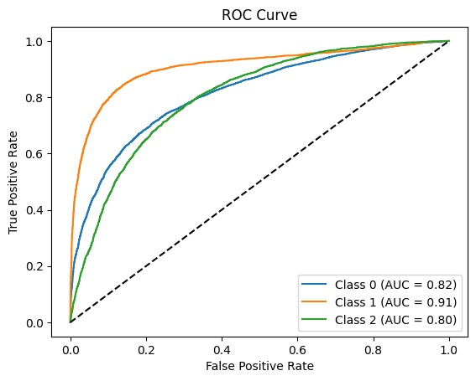
Naïve Bayes

Slide 16
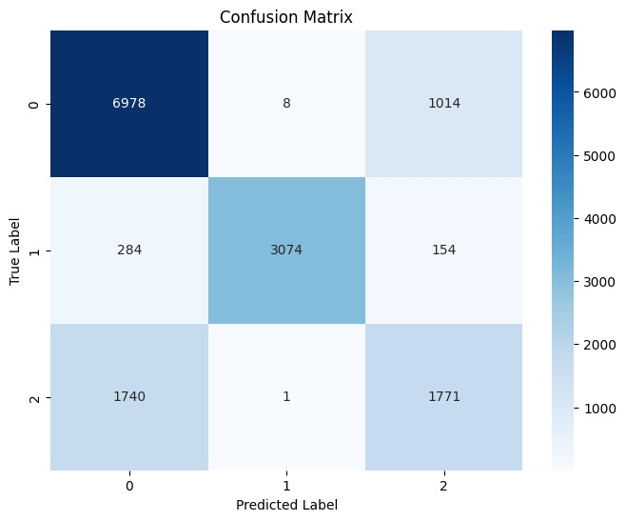
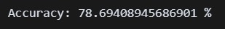
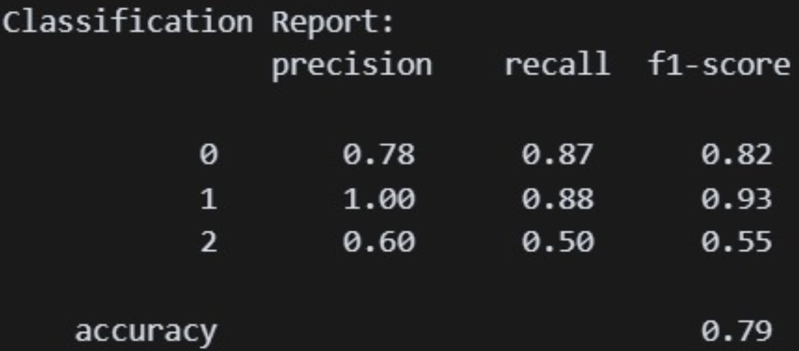
Neural Network

Slide 17
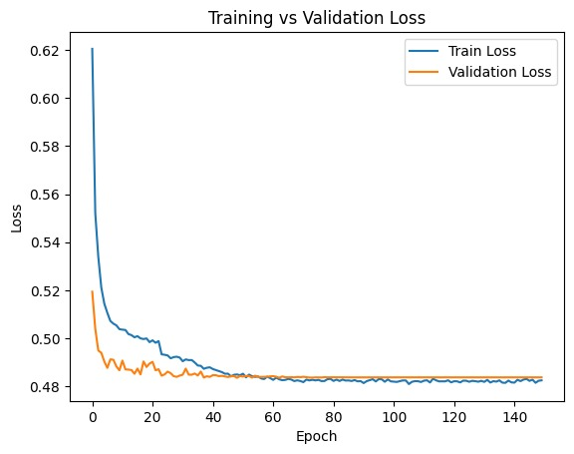
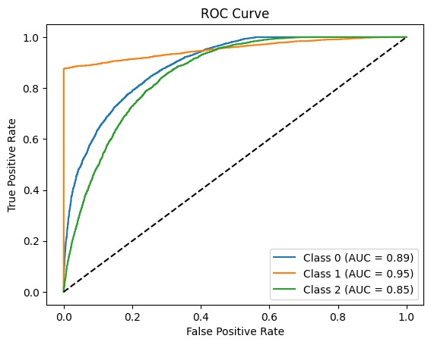
Neural Network

Slide 18
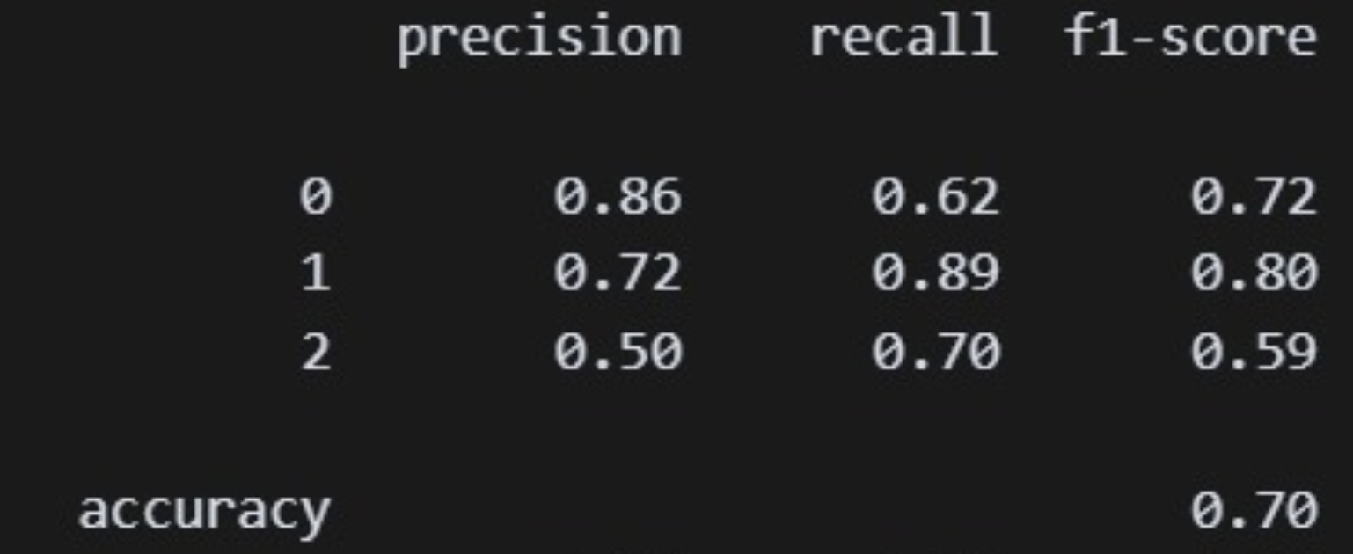
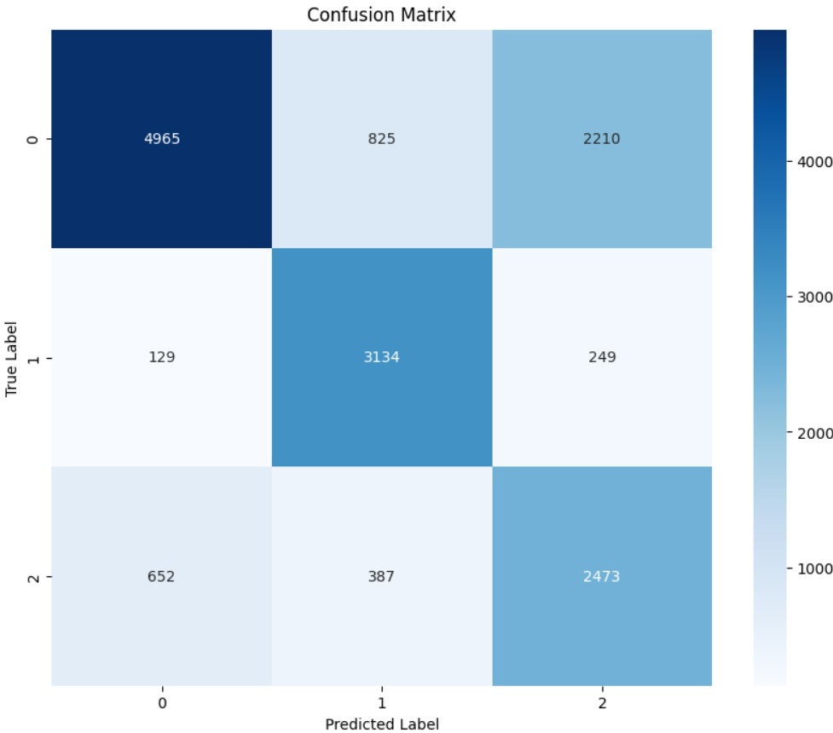
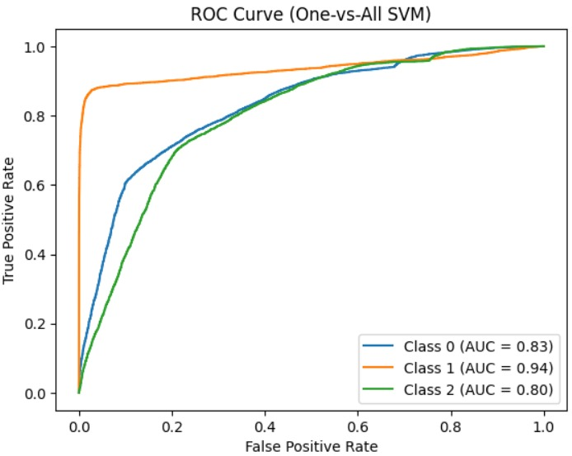
SVM

Slide 19
AUC & Accuracy Analysis
S.No | Algorithm | AUC (Class 0) | AUC (Class 1) | AUC (Class 2) | AUC (Average) | Accuracy
1 | KNN | 0.84 | 0.93 | 0.81 | 0.86 | 0.73
2 | Logistic Regression | 0.86 | 0.93 | 0.83 | 0.87 | 0.75
3 | Decision Tree | 0.73 | 0.93 | 0.68 | 0.78 | 0.77
4 | Random Forest | 0.79 | 0.94 | 0.71 | 0.81 | 0.79
5 | Naïve Bayes | 0.82 | 0.91 | 0.80 | 0.84 | 0.71
6 | Neural Network | 0.89 | 0.95 | 0.85 | 0.90 | 0.79
7 | SVM | 0.83 | 0.94 | 0.80 | 0.86 | 0.70

Slide 20
Precisson Analysis
S.No | Algorithm | Class 0 | Class 1 | Class 2 | Average
1 | KNN | 0.75 | 0.78 | 0.56 | 0.70
2 | Logistic Regression | 0.62 | 0.80 | 0.62 | 0.68
3 | Decision Tree | 0.76 | 1.00 | 0.58 | 0.78
4 | Random Forest | 0.79 | 1.00 | 0.59 | 0.79
5 | Naïve Bayes | 0.76 | 0.75 | 0.54 | 0.68
6 | Neural Network | 0.78 | 1.00 | 0.60 | 0.79
7 | SVM | 0.86 | 0.72 | 0.50 | 0.69

Slide 21
Recall Analysis
S.No | Algorithm | Class 0 | Class 1 | Class 2 | Average
1 | KNN | 0.81 | 0.83 | 0.43 | 0.69
2 | Logistic Regression | 0.84 | 0.87 | 0.45 | 0.72
3 | Decision Tree | 0.87 | 0.87 | 0.46 | 0.73
4 | Random Forest | 0.86 | 0.88 | 0.54 | 0.76
5 | Naïve Bayes | 0.76 | 0.73 | 0.54 | 0.68
6 | Neural Network | 0.87 | 0.88 | 0.50 | 0.75
7 | SVM | 0.62 | 0.89 | 0.70 | 0.74

Slide 22
F1-Score Analysis
S.No | Algorithm | Class 0 | Class 1 | Class 2 | Average
1 | KNN | 0.78 | 0.81 | 0.49 | 0.69
2 | Logistic Regression | 0.80 | 0.83 | 0.52 | 0.72
3 | Decision Tree | 0.81 | 0.93 | 0.51 | 0.75
4 | Random Forest | 0.86 | 0.94 | 0.54 | 0.78
5 | Naïve Bayes | 0.76 | 0.74 | 0.54 | 0.68
6 | Neural Network | 0.82 | 0.93 | 0.55 | 0.77
7 | SVM | 0.72 | 0.80 | 0.59 | 0.70

Slide 23
Thank You

